Slide 1
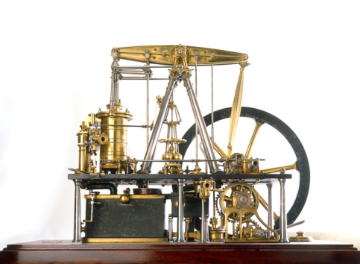
Chapter 7: The Industrial Revolution Begins 1750-1850 Section 1: The Beginning
Objectives
Analyze why life changed as industry spread.
Summarize how an agricultural revolution led to the growth of industry.
Outline the new technologies that helped trigger the Industrial Revolution.
What events helped bring about the Industrial Revolution?

Slide 2
Dawn of the Industrial Age
For thousand of years following the rise of civilization, most people lived and worked in small farming villages. However, a chain of events set in motion in the mid-1700s changed that way of life for all time. Today, we call this period of change the Industrial Revolution.
The Industrial Revolution started in Britain. The economic changes that Britain experienced affected people’s lives an much as political changes and revolutions had. In contrast with most political revolutions , it was neither sudden nor swift, Instead it was long, slow, uneven process in which production shifted from simple hand tools to complex machines. From its beginnings in Britain, the Industrial Revolution has spread to the rest of Europe, North America, and around the globe.

Slide 3
Life Changes as Industry Spreads
1750s
1850s
Most people worked the land using handmade tools.
Lived in simple cottages lit by firelight & candles.
Made their own clothing & grew their own food.
Few left home; feet or horse drawn cart
They might exchange goods at a weekly outdoor market.
People knew little about the world that existed beyond their village.
Industrial towns and cities.
Buy clothing & food that someone else produced.
Travelers moved rapidly between countries and continents by train or steamship.
New Inventions
Telegraph
Anesthetic
Sewing machine
Speed of light measured

Slide 4
Why was the Industrial Revolution a turning point in world history?

Slide 5
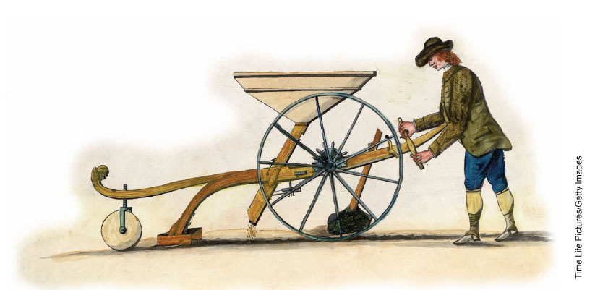
Agriculture Spurs Industry
The Industrial Revolution was made possible in part by a change in farming fields in Western Europe. Then a second agricultural revolution took place that greatly improved the quality and quantity of farm products.
Farming Methods Improve:
The Dutch led the way
Built earthen walls known as dikes to reclaim land from the sea.
Combined smaller fields into larger ones to made better use of the land and used fertilizer from livestock to renew the soil.
1700s British farmers expanded on Dutch experiments
Educated farmers exchanged news of experiments through farm journals.
Mixed different kinds of soils
New methods of crop rotation
Lord Charles Townshend – grow Turnips, which restore exhausted soil.
Jethro Tull invented a new mechanical device, the seed drill.
It deposited seeds in rows rather
than scattering them wastefully
over the land.

Slide 6
Enclosure Increases Output Causes Migration
Rich landowners pushed ahead with enclosure, the process of taking over and consolidation land formally shared by peasant farmers.
1700s wanted to create larger fields to cultivate more efficiently.
British Parliament facilitated enclosures through legislation.
Effects:
As millions of acres were enclosed, farm output increased and profits rose – (needed fewer workers).
Many farm laborers were thrown out of work and small farmers we forced off their lands because they could not compete.
Villages shrank as people migrated in search for work. Eventually, over time, jobless farm workers settled in towns and cities and would tend to machines of the Industrial Revolution.

Slide 7
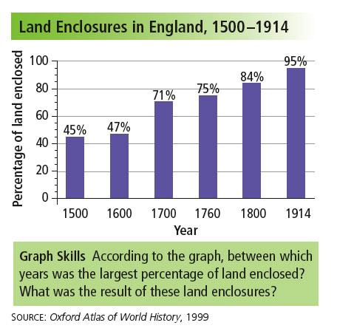
Answer: Between 1600 and 1700; farm output and profits rose, but small farmers were forced off the land and eventually migrated to cities to find work.

Slide 8
Population Multiplies
The agricultural revolution contribute to a rapid growth in population. Britain's population soared from about 5 million in 1700 to almost 9 million in 1800.
The population of Europe as a whole shot up from roughly 120 million to about 180 million during the same period.
Such population growth had never been seen before.
Why Did The Population Increase Occur?
Agricultural revolution reduced the risk of death from famine because it created a surplus of food.
People ate better = healthier.
Better hygiene and sanitation
Improved medical care

Slide 9
How did an agricultural revolution contribute to population growth?

Slide 10
New Technology Becomes Key
Another factor that helped trigger the Industrial Revolution was the development of new technology. Aided by new sources of energy and new materials, these new technologies enabled business owners to change the ways work was done.

Slide 11
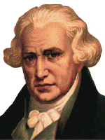
New Technology
During the 1700s, people began to harness new
sources of energy.
Coal used to develop the steam engine.
1712, British inventor Thomas Newcomen developed a steam engine powered by coal to pump water out of mines.
Scottish engineer James Watt looked to improve on Newcomen’s design and made it more efficient. His improvements would open the door for not only operating machinery but eventually powering locomotives and steamships.
Known as: “Father of the Industrial Revolution.”

Slide 12
The differences between these two steam driven machines is subtle and not quite obvious, but the one on the right displays Watt's improvement over the earlier device. Watt's is remarkable for its precision and increase in force. It was to have revolutionized the world because of its versatility, relative ease of repair, fuel, and efficiency.
The Newcomen Engine
Watt's condensing Engine

Slide 13
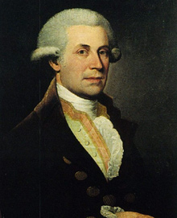
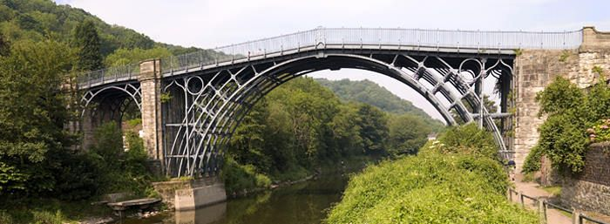
The Quality of Coal Improves
Coal was also a vital source of fuel in the production of iron, a material needed for the construction of machines and steam engines.
In 1709, Abraham Darby used coal instead of charcoal to smelt iron, or separate iron from its ore.
His experiments led him to produce less expensive and better-quality iron.
Abraham Darby III built the world’s first iron bridge.
Iron would be used more and more widely, especially after the world turned to building railroads.

Slide 14
What new technologies helped to trigger the Industrial Revolution?

Slide 15
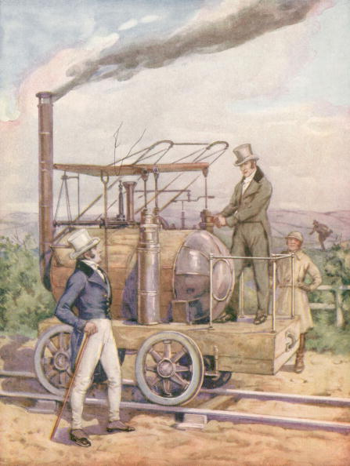
Chapter 7 The Industrial Revolution Begins (1750-1850) Section 2 – Britain Leads the Way
Objectives:
Understand why Britain was the starting point for the Industrial Revolution.
Describe the changes that transformed the textile industry.
Explain the significance of the transportation revolution.
What key factors allowed Britain to lead the way in the Industrial Revolution?

Slide 16
Terms and People
capital – money to invest in enterprises
enterprise – a business organization in an area such as shipping, mining, railroads, or factories
entrepreneur – someone who manages and assumes the financial risks of starting a new business
putting-out system – cottage industry; raw cotton was distributed to peasant families, who spun it into thread and then wove the thread into cloth in their homes
Eli Whitney – in 1793, invented the cotton gin, which sped up the previously time-consuming job of separating cotton fibers from cotton seeds
turnpike – private road built by an entrepreneur who charged travelers a toll, or fee, for use
Liverpool to Manchester – site of the world's first major rail line in 1830

Slide 17
A number of characteristics made Britain ripe for industrialization in the eighteenth century.
Natural ports
Navigable rivers
Water for canals
Access to the sea
A plentiful supply of coal
Vast supplies of iron
Britain had plentiful natural resources, including:

Slide 18
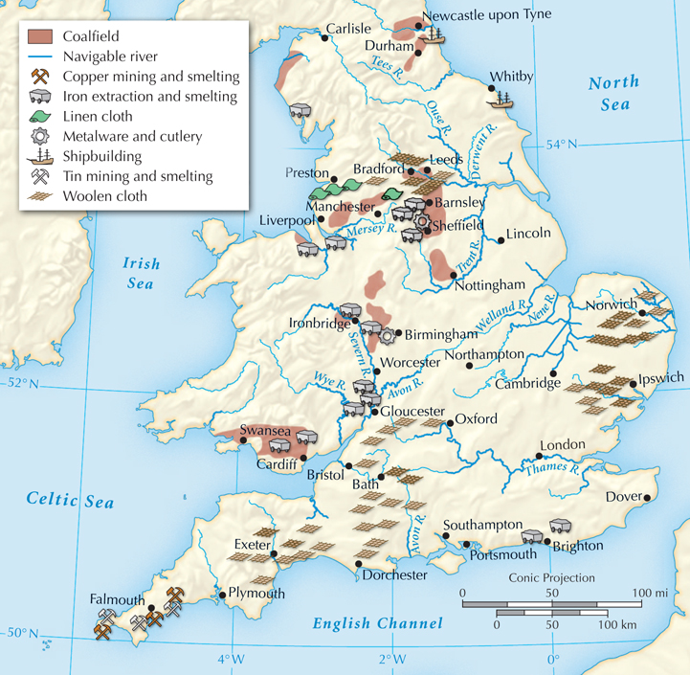
England’s Resources and Industries, 1750

Slide 19
In the 1700s, Britain had skilled inventors, a ready workforce, and a growing population.
To meet the growing demand for jobs and products, one more thing was needed:
capital, or money to start new businesses.
Entrepreneurs needed capital to invest in business enterprises such as shipping, mining, and manufacturing.
With a healthy economy, many were now willing to risk their money on new ventures.
From the mid-1600s, England had prospered from trade.
A business class had accumulated
the needed capital.

Slide 20
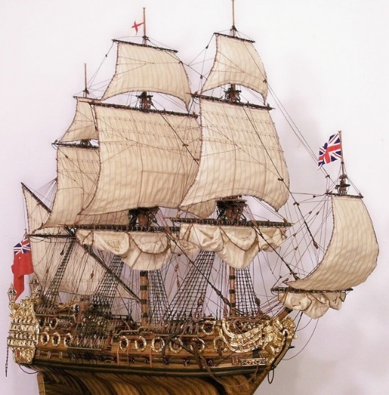
Britain had additional advantages.
Britain had a stable government that supported economic growth.
Other countries had river tolls, but Britain had no such barriers.
The powerful British navy protected shipping and overseas trade.

Slide 21
In the 1600s, cotton cloth from India became popular in Britain. Using the putting-out system, merchants began a cotton cloth industry in Britain.
Merchants gave cotton to peasant families, who spun thread and wove cloth at home as a cottage industry.
Skilled artisans in towns then finished and dyed the cloth.
But the putting-out system was too slow to meet the growing demand for cotton cloth.

Slide 22
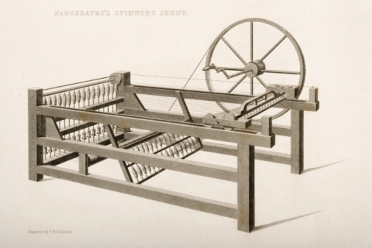
New inventions increased and sped up textile production in the 1700s.
The flying shuttle made weaving faster.
The spinning jenny spun several threads at once.
The water frame used running water to power the process.
The spinning jenny, invented
by James Hargreaves

Slide 23
Machines were too large to put in peasant homes, so they were placed in large sheds along swift-moving rivers, which provided power. Workers came to labor in these early factories.
The new machines doomed the putting-out system.
Factories brought together workers and machinery to produce large quantities of goods.

Slide 24
It took a long time to separate cotton fibers from cotton seeds, limiting production.
In 1793, an American, Eli Whitney, invented the cotton gin, which quickly did the job.
Cotton production soon increased exponentially.
The new machines posed a problem. How could farmers provide enough cotton to meet English demand?

Slide 25
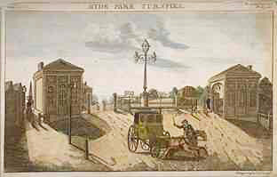
Changes in industry soon sparked a transportation revolution in England.
With increased production came a need for cheaper ways of moving products.
Some entrepreneurs invested in turnpikes.
Products traveled faster on these roads.
England was soon linked by a series of roads.

Slide 26
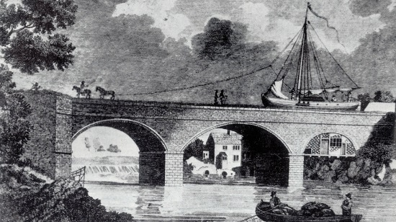
Factory owners needed still more efficient and inexpensive ways to move goods.
Engineers designed stronger bridges and upgraded harbors.
They also dug canals to link rivers or to connect inland towns to coastal ports.
The owners profited from the tolls, while the price of coal in the city of Manchester was cut in half.
This success set off a canal-building frenzy.
In 1763, the Bridgewater canal was opened.

Slide 27
Railroads had an even greater impact on the transportation revolution.
In the early 1800s, inventors such as George Stephenson developed steam-powered locomotives.
Locomotives could pull carriages along iron rails to places canals could not reach.

Slide 28
Railroads did not have to follow rivers, allowing for the quick and efficient shipment of goods over land.
The Liverpool to Manchester line opened in 1830. It began a railroad-building boom.
Railroad lines crisscrossed England, Europe, and the United States by 1870.

Slide 29
The new technology set off a cycle that dramatically affected how people lived.
More affordable goods caused still lower prices.
Lower prices created more consumers and greater demand.
Greater demand led to new inventions and still more affordable goods.

Slide 30
What key factors allowed Britain to lead the way in the Industrial Revolution?
Changes in agricultural practices fueled population growth but left many farmers homeless and jobless. The population boomed in the towns and cities as people migrated from rural areas. These migrants provided labor for factories and coal mines.
Population growth was one of several factors that led to the Industrial Revolution in Britain.

Slide 31
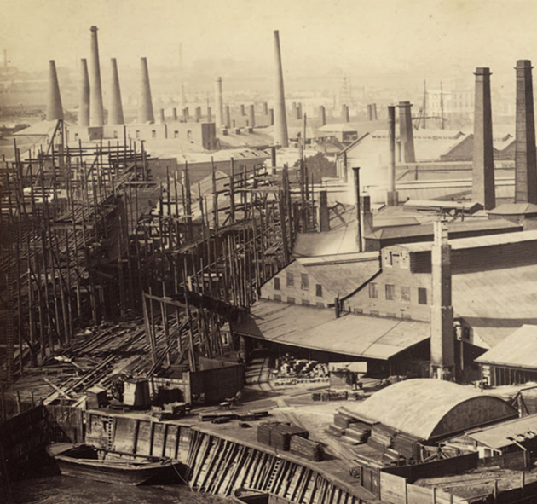
Chapter 7 - The Industrial Revolution Begins (1750-1850) Section 3: Social Impact of the Industrial Revolution
Objectives
Explain what caused urbanization and what life was like in the new industrial cities.
Compare and contrast the industrial working class and the new middle class.
Understand how the factory system and mines changed the way people worked.
Compare the costs and benefits of industrialization.
What were the social effects of the Industrial Revolution?

Slide 32
Social Impact of the Industrial Revolution
The Industrial Revolution brought great riches to most of the entrepreneurs who helped set it in motion. For the millions of workers who crowded into the new factories, however, the industrial age brought poverty and harsh living conditions.
In time, reforms would curb many of the worse abuses of the early industrial age in Europe and the Americas. As standards of living increased, people at all levels of society would benefit from industrialization. Until then, working people would suffer with dangerous working conditions; unsafe, unsanitary, and overcrowded housing; and unrelenting poverty.

Slide 33
People Move to New Industrial Cities
The Industrial Revolution brought rapid urbanization, or the movement of people to cities.
Changes in farming, soaring population growth, and an ever increasing demand for workers led to city growth.
Almost overnight, small towns around coal or iron mines mushroomed into cities.

Slide 34
New Social Classes Emerge
Those who benefited the most from the Industrial Revolution were the entrepreneurs who set it in motion. (Wealthy)
Industrial Middle Class
Owned and operated the new factories, mines, and railroads - other industrials.
Comfortable Lifestyle
Bourgeoisie or “middle class”- whose members came from varied backgrounds.
Some were merchants who invested their growing profits in factories.
Others were inventors or skilled artisans who developed new technologies.
Some rose from “rags to riches” (greatly admired).
Lived in well-furnished, spacious homes on paved streets and had a ready supply of water.
Fancy clothing and ate well.
Took pride in their hard work and their determination to “get ahead.”
Few had sympathy for the poor.
Women did NOT leave the home to work but instead focused on rising children.

Slide 35
The Industrial Working Class
The vast number of poor struggled to survive in foul-smelling slums.
They were packed into tiny rooms in tenements, or multistory buildings divided into apartments.
No running water, only community pumps.
No sewage or sanitation system, so wastes and garbage rotted in the streets.
Sewage dumped into rivers, which created an overwhelming stench and contaminated drinking water that led to the spread of diseases, such as, cholera.

Slide 36
Workers Stage Futile Protests
Labor unions, or workers organizations, were illegal at this time, however secret unions did exist. (Britain).
They wished to initiate worker reforms, such as increase pay, but had no political power to effect change.
Sometimes their frustrations led to violence.
Groups of textile workers known as the Luddites resisted the labor-saving machines that were costing them their jobs.
Smashed textile machines and burned factories.

Slide 37
Workers find Comfort in Religion
Many working-class people found comfort in a religious movement classed Methodism. Methodist meetings featured hymns and sermons promising forgiveness of sin and a better life to come.
John Wesley stressed the need for a personal sense of faith.
He encouraged his followers to improve themselves by adopting sober; moral ways.
Methodists went into the slums to rekindle hope among the working poor.
Set up Sunday schools
Studied the Bible, learned to read and write.
Helped channel workers anger away from revolution and toward reform.

Slide 38
Life in the Factories and Mines
The heart of the new industrial city was the factory. There, the technology of the machine ae ad he rapid pace of industrialization imposed a harsh new way of life on workers.
In grim factories of industrial towns, workers faced a rigid schedule set by the factory whistle.
12-16 hours working; six or seven days a week.
Could only take breaks when factory owners gave permission.
Exhausted workers suffered accidents from machines with no safety devices.
Those who became sick or injured lost their jobs.
Early on women were preferred because owners thought could adapt more easily to the machines and were easier to manage.
Generally women were paid half what they paid men.
Double burden for women, had to work and still take care of the family.

Slide 39
Miners Face Worse Conditions
Working conditions in the mines were far worse than in the factories.
Worked in darkness and coal dust destroyed their lungs.
Dangers of explosions, flooding, and collapsing tunnels.
Women and children carted heavy loads of coal, sometimes on all fours in low passages
Children
Often started working at 7 or 8; some at 5.
Nimble fingers and quick-moving, they changed spools in textile mills, and crawled under machinery to repair broken threads.
In the mines, some sat all day in the dark, opening and closing air closing air vents.
Others hauled coal carts.
Child labor reform laws called “factory acts” were passed in the early 1800s.
Reduce workday to 12 hours
Remove children under the ae of 8 from cotton mills

Slide 40
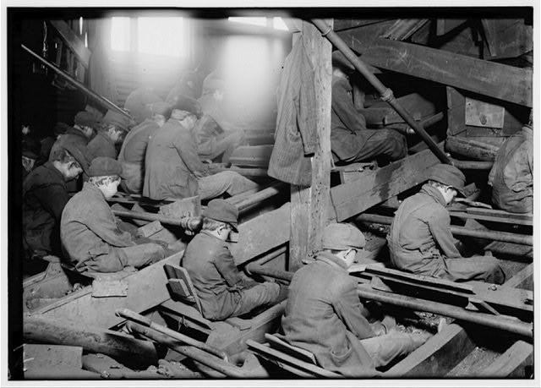
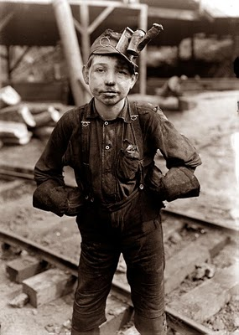
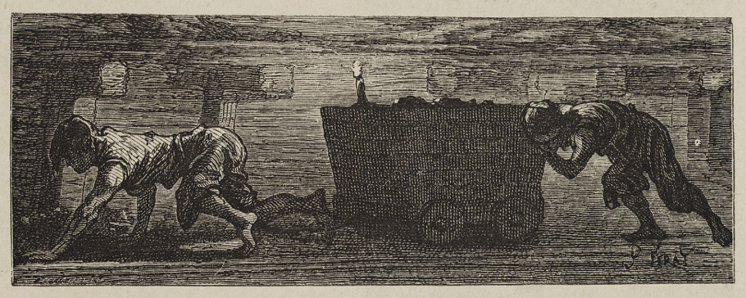
1. What do you notice in these primary sources?
2. What can it tell us about child labor during
the Industrial Revolution?
3. How was work in mines different than work on farms?

Slide 42
The Results of Industrialization
Since the 1800s, people have debated whether the Industrial Revolution was a blessing or a curse. The early industrial age brought terrible hardships. In time, however, reformers pressed for laws to improve working conditions. Labor unions won the right to bargain with employers for better wages, hours, and working conditions. Eventually, working-class men gained the right to vote, which gave them political power.
Despite the social problems created by the industrial revolution—low pay, dismal living conditions—it did have some positive effects. As demand for mass-production goods grew, new factories opened, which in turn created more jobs. Wages rose so that workers had enough left after paying rent and buying food to buy a newspaper or visit a music hall. As the cost of railroad travel fell, people could visit family in other towns. Horizons widened and opportunities increased.

